Slide 1
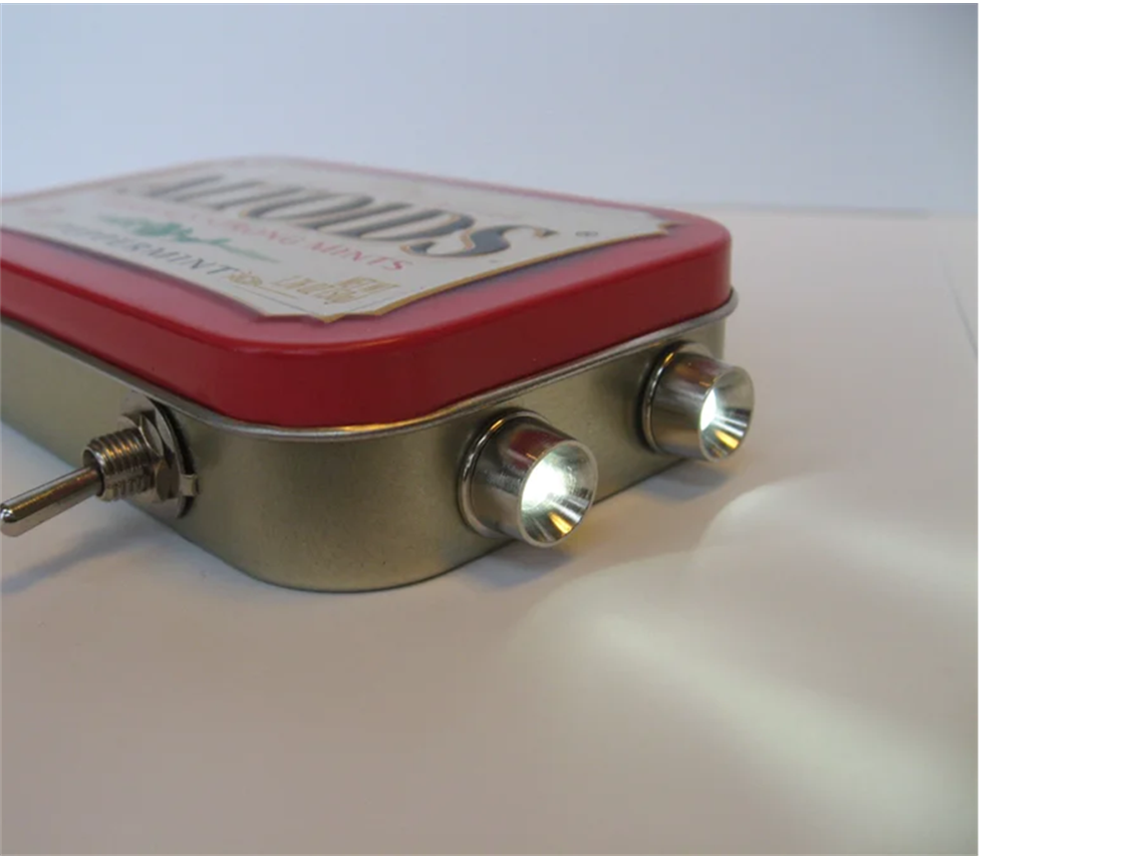
DIY Flashlight Workshop
What are we making?
HINT !
Has Polarity
Uses Ohm's Law
Uses Voltage and Currents
Has a Breadboard
Light-hearted fun ☺
IEEE
Notes:
Hook audience attention by having them guess what we are making; the pun should give it away hopefully…

Slide 2
Definitions

Slide 3
What is a voltage?
Notes:
For each question I advise 2-3 hands and as we edge closer to 15 minutes only take one response and move on

Slide 4
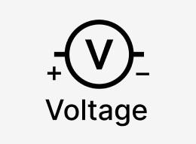
Voltage
“The measurement of the amount of charge between two points
Opposite charges attract; Like charges repel
This “push” of the charges trying to repel each other is voltage!
Notes:
Stress the importance of push

Slide 5
Where does the voltage come from?
Notes:
For each question I advise 2-3 hands and as we edge closer to 15 minutes only take one response and move on

Slide 6
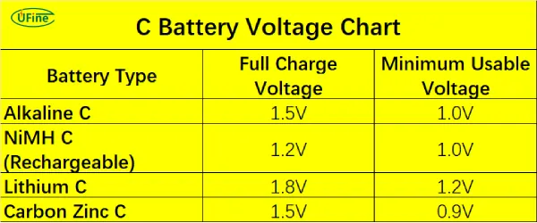
Voltage Supply
Terminals (Negative and Positive Sides)
Unit of Voltage Volts (V)
Voltage loss in circuit, not created
Batteries have a specified voltage used for circuits
One may call it… its
Potential energy
Notes:
Explain batteries have specific voltage and dedicated terminals (positive and negative sides) that determine the direction of push
Voltage is supplied by the battery
Unit of Voltage is Volts (V)
Voltage is loss through the circuit but cannot be generated (law of energy conversion, energy cannot be created nor destroyed)

Slide 7
What is Current?

Slide 8
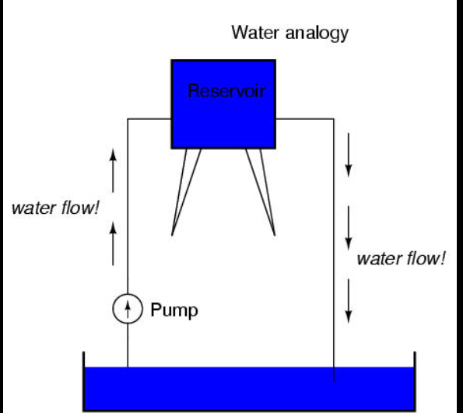
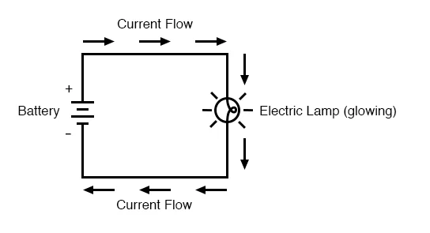
Case Study: Water Flow
What does water have to do with electrical current?
Notes:
Useful Analogy - Water: voltage ~ water pressure -> higher voltage affect current flow
Explain current here with water flow as an example
High Voltage (positive) to Low Voltage (ground)

Slide 9
What does LED stand for?

Slide 10
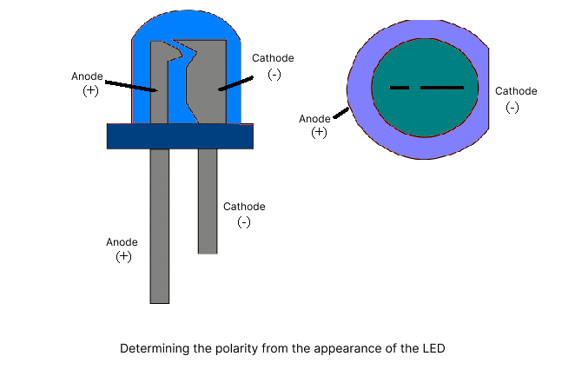
LED (Light Emitting Diode)
Produces light with the movement of electrons
Diode Property: one direction
Ex. one way street
Polarity: Positive long leg, negative short leg
Also requires specific voltage (may lead to damage!)
Notes:
LED: Positive and Negative Side (same as a battery)
This movement leads to light being emitted
Produces light when electric current
Diode property: one way valve (don’t go against a one way street!)
Polarity: positive long leg, negative short leg
Also requires a specific voltage/current (may lead to damage!)

Slide 11
What We Are Building
Battery (Chemical to Electrical) | 3 Volts
LED (Electrical to Light) | 2 Volts with 15 mA
But 3 Volts > 2 Volts
How can we fix this ?
Notes:
Introduce compatibility issue -> Resistance

Slide 12
What is Resistance?

Slide 13

Resistance
“Hinders the electric current in a circuit”
Higher Resistance = Higher Voltage Loss
Lower Resistance = Lower Voltage Loss
Notes:
Electrical Component = Resistor
Unit of Resistance is ohm
Voltage is spent to push the current through the resistor aka voltage is loss when current goes through the resistor

Slide 14
How much resistance do we need?

Slide 15
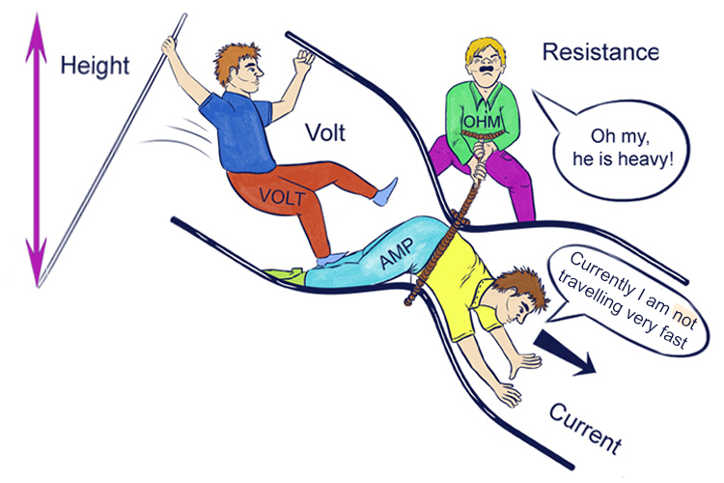
Ohm’s Law
Voltage = Current * Resistance
(1 V)= (15 mA) * R
15 mA = 0.015 A
R = 1 V / 0.015 A
=
R =
~70 ohms
Round up to 100 ohms

Slide 16
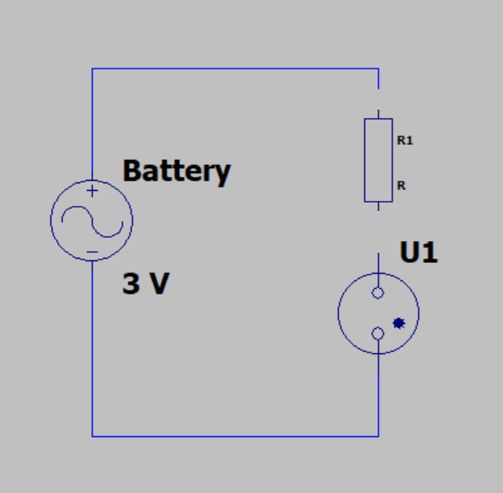
Resistor
1 V
3 V
LED
2 V
Notes:
Explain Circuit Design aka what symbols represent what electrical components
Explain the Circuit Design

Slide 17
What are we building?

Slide 18
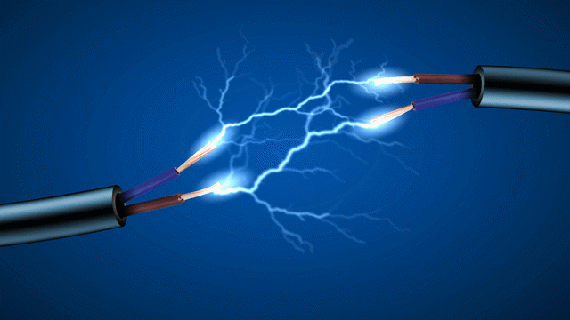
What is the unit for current
Amps
Notes:
Describe LED and components
Direct to diagram (EX: purple for N-type and green for P-type)
Function explanation:
Between the two semiconductors is a barrier to stop the charges from crossing.
The barrier becomes less effective as voltage is increased
As the barrier stops working, charges move across the junction. When a positive and negative charge combine, you get light

Slide 19
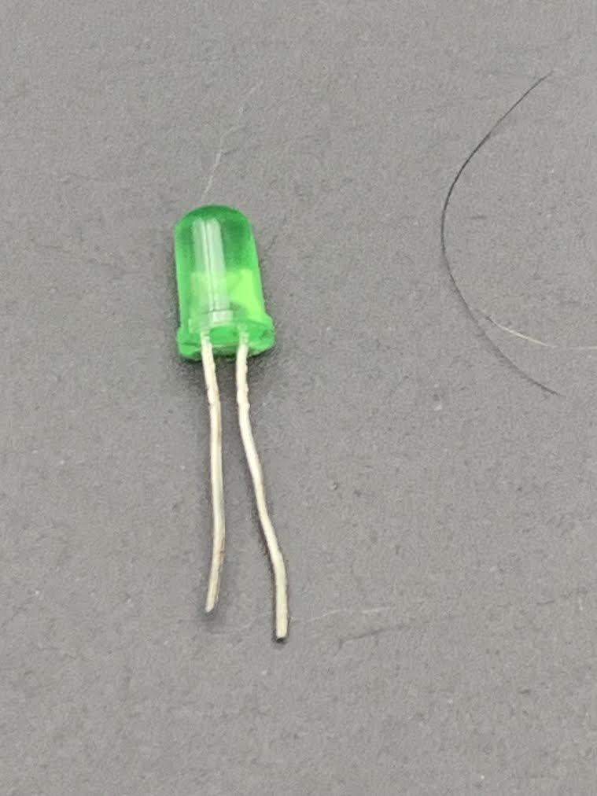
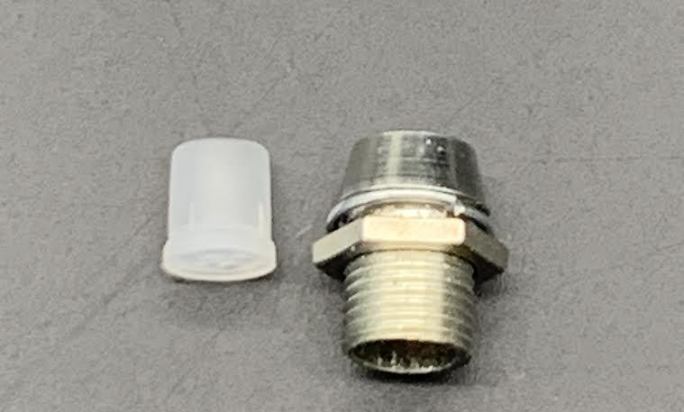
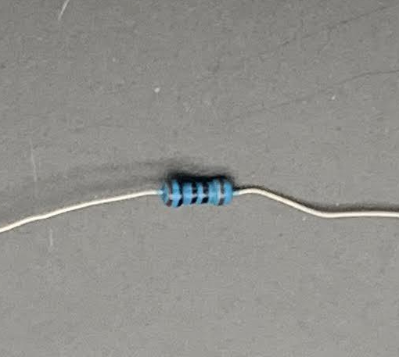
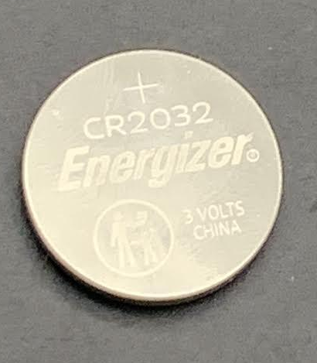
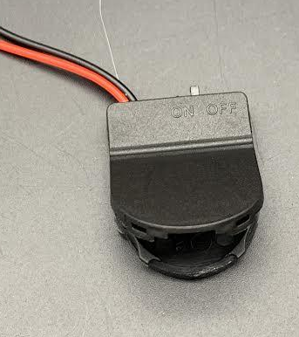
Materials
2x Clear 5mm LEDs
2x 5mm LED Holder - Chrome
1x 100 Ohm resistors
1x 3V CR2032 battery and holder
1x Plastic container
Notes:
Distribute materials here

Slide 20
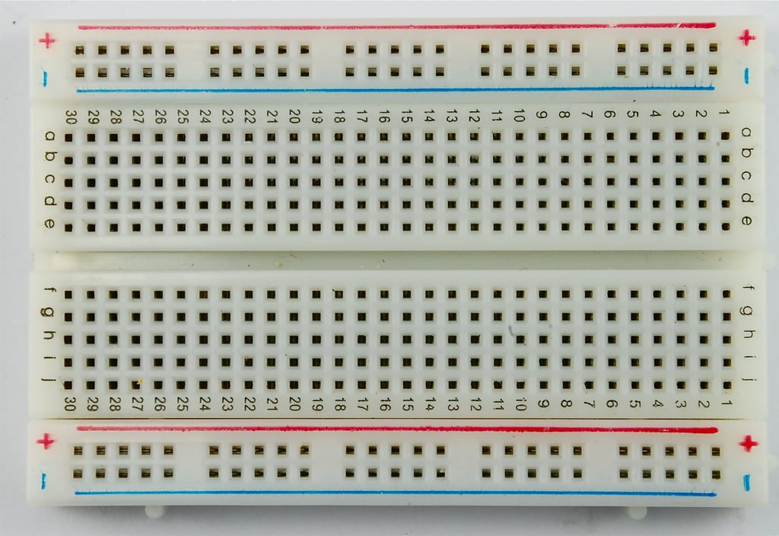
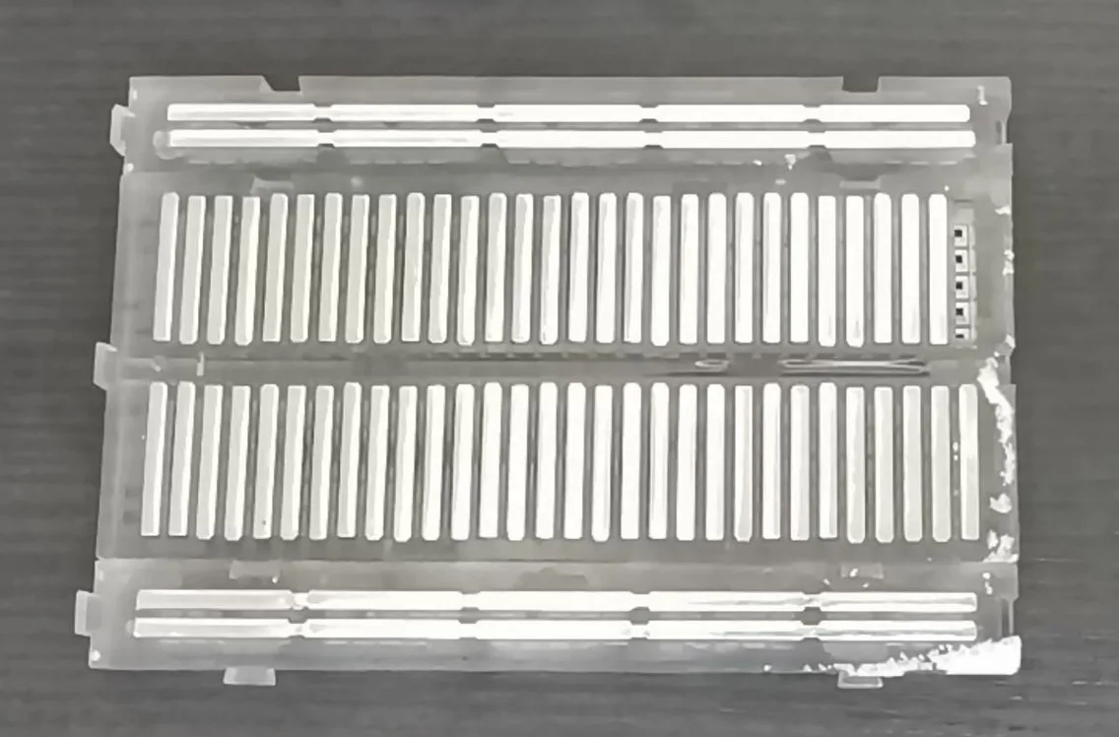
How do breadboard work?
A typical breadboard (front)
A typical breadboard (back)
Notes:
Metal strips are the nodes of the breadboard
Voltage in the node is the same throughout
Resistor / Components goes into the node with other resistors / components that have the same voltage

Slide 21

Our Breadboard
1 2 3
Notes:
Different color circles = different nodes
Ask how many nodes do we need to use to build our circuit (aka how many different voltage values there are throughout the circuit)

Slide 22
Let’s Make Flashlights!

Slide 23
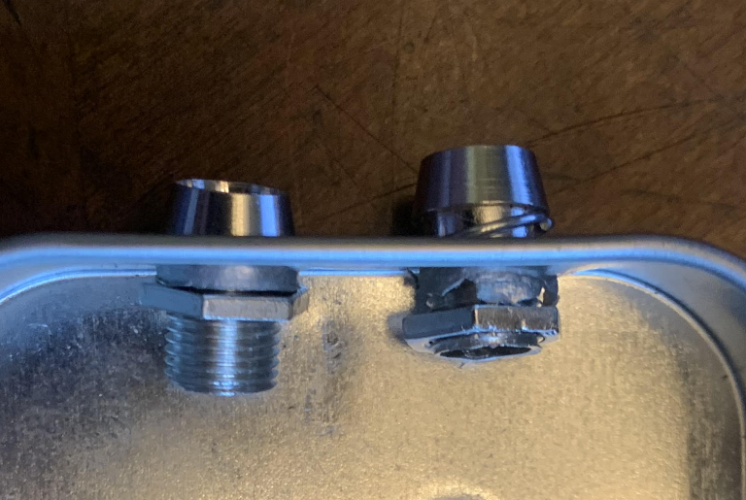
Step 1 – Prepare the container
Screw on LED holders

Slide 24
TheThe
Cathodes & Anodes
Anode (+)
Positive side
Long leg
Cathode (-)
Negative side
Short leg

Slide 25
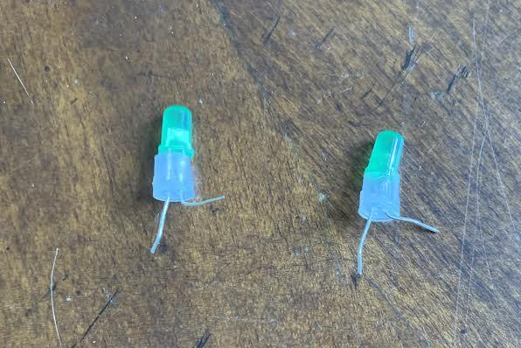
Step 2 – Prepare the LEDs
1. Insert both LED legs through the plastic holder.
2. Pull shorter leg (-) up by 90 degrees (this leg is the negative side of the LED)
Pay attention to which side is negative!

Slide 26
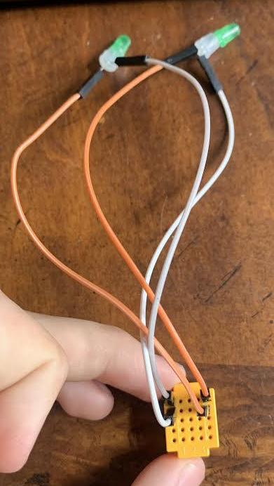
Step 3 – Connect the LEDs
Connect short leg (-) of LED to left column of board.
Connect long leg (+) to the right column of board.
(Important: LEDs only work when electricity flows in the right direction.)
Note: Colors of wire shown might not coordinate with your own.

Slide 27
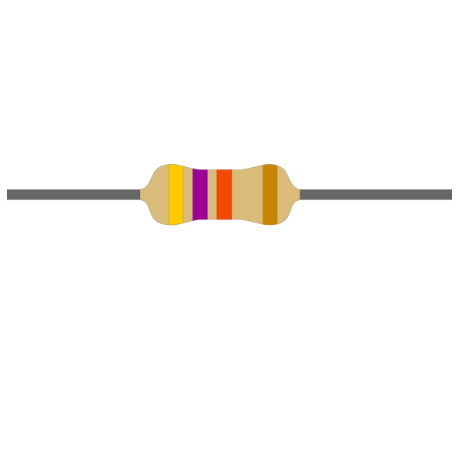
Add in the battery.
Black Leg = Short (-)
Red Leg = Long (+)
And the resistor

Slide 28
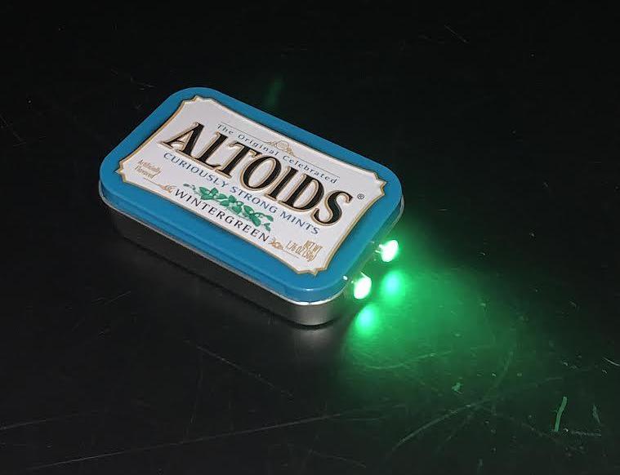
Step 4 – Assemble
Neatly organize your components in a plastic container.
Switch the battery connector

Slide 29
Your flashlight is now complete!

Slide 30
Review

Slide 31
What did we make today?
Flashlight
Notes:
Describe LED and components
Direct to diagram (EX: purple for N-type and green for P-type)
Function explanation:
Between the two semiconductors is a barrier to stop the charges from crossing.
The barrier becomes less effective as voltage is increased
As the barrier stops working, charges move across the junction. When a positive and negative charge combine, you get light

Slide 32
Describe the conversion of energy
Battery:
LED:
Chemical -> Electrical
Electrical -> Light
Notes:
Describe LED and components
Direct to diagram (EX: purple for N-type and green for P-type)
Function explanation:
Between the two semiconductors is a barrier to stop the charges from crossing.
The barrier becomes less effective as voltage is increased
As the barrier stops working, charges move across the junction. When a positive and negative charge combine, you get light

Slide 33
The End!
Congratulations on building your very own flashlight!
Notes:
Hand out how to make DIY circuit take home sheet

Slide 34

https://www.instructables.com/Paper-Circuits/

